Slide 1
Marketing Requirements

Slide 2
Hobby Tracker
The software product we are going to develop is an Android app named Hobby Tracker.

Slide 3
The Target Customers
The target customers are those who have some hobbies and want to track their progress using cellphones.
For example, to practice the chords of guitar, a set shot of basketball, or to solve life and death problems of Go, etc.

Slide 4
Potential Competitive Products
Products are in competition with Hobby Tracker: Apps used in cellphone, such as WeChat Sports, which is made by Tencent, the biggest IT company in China.

Slide 5
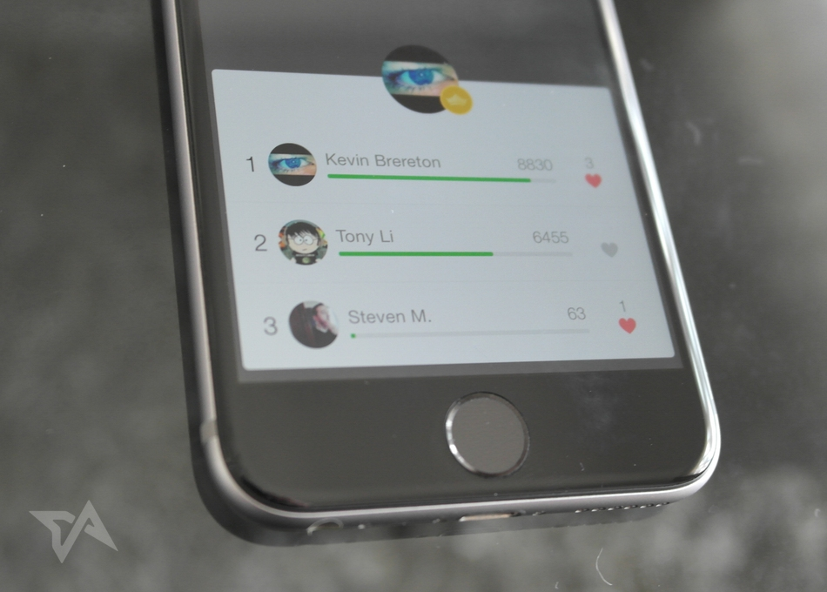

Slide 6
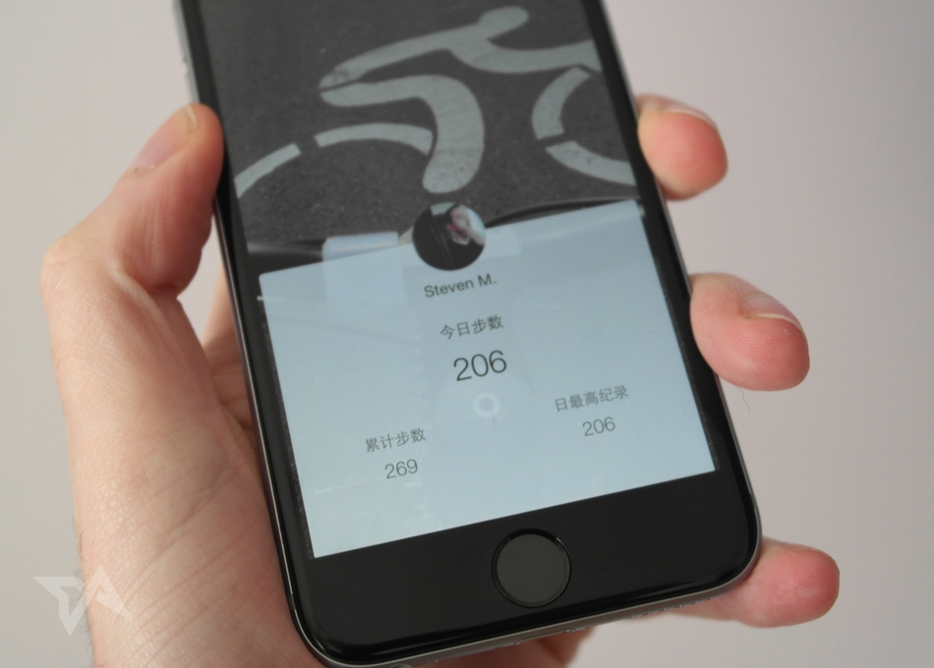

Slide 7
Hobby Tracker only counts what you have finished each day , and shows a cumulative total, so it doesn’t reveal more sensitive info like your locations or specific times that you’re moving.

Slide 8
Customers are likely to use Hobby Tracker
1 – Your profile shows your daily achievement as well as a cumulative total
2 – All you done can be turned into a social competition, complete with a daily leaderboard that covers all your friends who have also opted in.
3 – You can even build a great community for your own.

